Slide 1
Text Scaffolds for Effective Surface Labeling
Gregory Cipriano and Michael Gleicher

Slide 2
The Idea: Placing Text on a Surface
?

Slide 3
The Idea: Placing Text on a Surface

Slide 4
The Idea: Placing Text on a Surface
Corpus Callosum
Text scaffold
Parietal Lobe

Slide 5
The Idea: Placing Text on a Surface

Slide 6
The Art of Cartography
Cartographers have been labeling in 2D (and on globes) for thousands of years…
And they’re getting pretty good at it:

Slide 7
The Art of Cartography
Basic principles:
Text should be legible
Smooth, likely straight, path
Text should be visible
Always on top of other features
Text may track important features
E.g. roads, rivers
Text should be close to labeled feature

Slide 8
What about in 3D?
The same principles apply

Slide 9
Goals
Legibility
Text must be readable
Surface must be smooth
Visibility
Surface can’t enter occluded regions
Surface must bound object
Proximity
Labels must lie as close as possible to corresponding region
Shape-conveying
Scaffold should retain as much of the original shape as possible.
Notes:
Add big picture (contribution) – concept of scaffold surface
What It means to make a good surface for labeling
Add outline

Slide 10
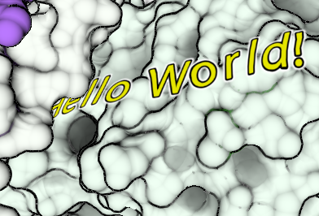
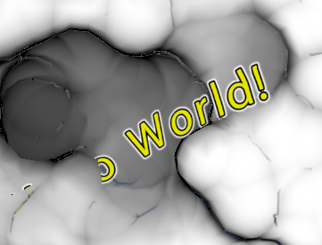
Goals
Legibility
Text must be readable
Surface must be smooth
Visibility
Scaffold can’t enter occluded regions
Scaffold must bound object
Proximity
Labels must lie as close as possible to corresponding region
Shape-conveying
Scaffold should retain as much of the original shape as possible.
Notes:
Add big picture (contribution) – concept of scaffold surface
What It means to make a good surface for labeling
Add outline

Slide 11
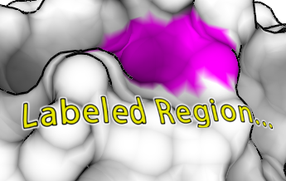
Goals
Legibility
Text must be readable
Surface must be smooth
Visibility
Surface can’t enter occluded regions
Surface must bound object
Proximity
Labels must lie as close as possible to corresponding region
Shape-conveying
Scaffold should retain as much of the original shape as possible.
Notes:
Add big picture (contribution) – concept of scaffold surface
What It means to make a good surface for labeling
Add outline

Slide 12
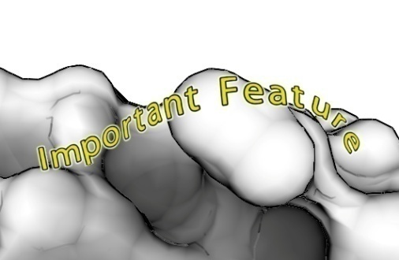
Goals
Legibility
Text must be readable
Surface must be smooth
Visibility
Surface can’t enter occluded regions
Surface must bound object
Proximity
Labels must lie as close as possible to corresponding region
Shape-conveying
Scaffold should retain as much of the original shape as possible.
Notes:
Add big picture (contribution) – concept of scaffold surface
What It means to make a good surface for labeling
Add outline

Slide 13
Outline
Introduction
Text Scaffold Generation
Labeling
Results

Slide 14
Outline
Introduction
Text Scaffold Generation
Labeling
Results

Slide 15
Text Scaffold Generation
Notes:
Give connection to four principles
Take deep breath

Slide 16
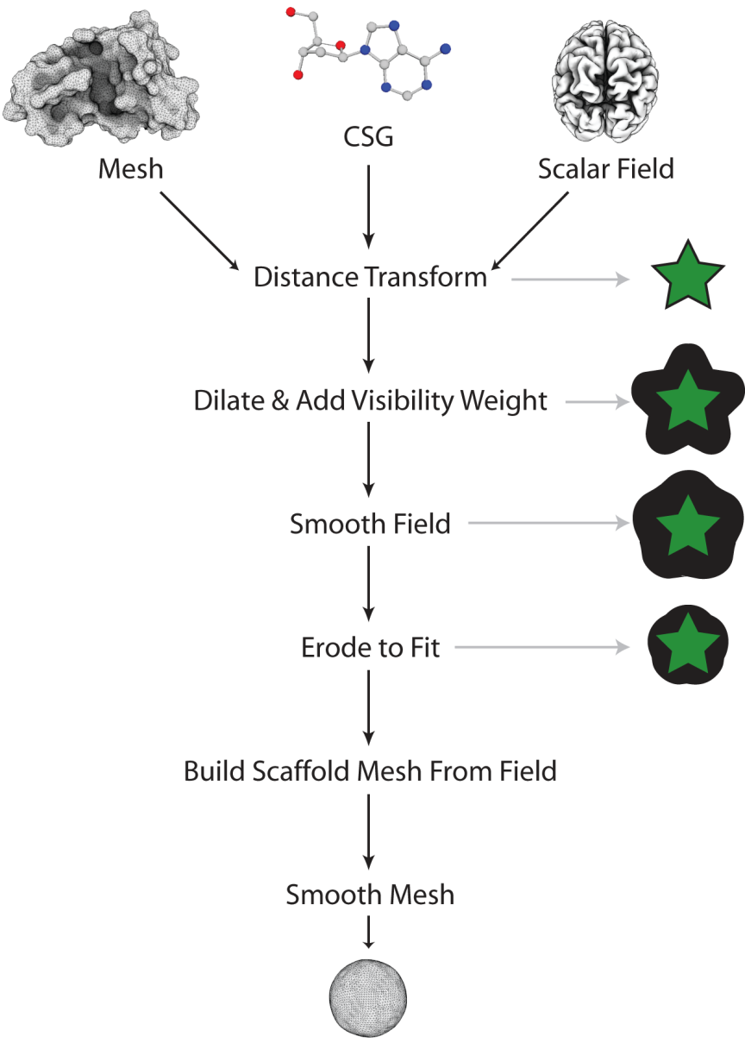
Text Scaffold Generation Step 1: Build Distance Field
Why a Distance Field?
Compatible with any input source
Allows arbitrary topological changes
Quick, and simple to work with
* R. Satherley and M. W. Jones. Vector-city vector distance transform. Computer Vision and Image Understanding, 82:238–254, 2001.

Slide 17
Text Scaffold Generation Step 1: Build Distance Field
Steps:
Rasterize into voxels
From mesh or CSG source
In all figures: 40³
Then build distance field
We use the Vector-City Vector Distance Transform*
Each voxel contains the scalar distance to surface
Negative inside object, positive outside
* R. Satherley and M. W. Jones. Vector-city vector distance transform. Computer Vision and Image Understanding, 82:238–254, 2001.

Slide 18
Text Scaffold Generation Step 2: Dilate & Add Visibility Weight
What is visibility weight?

Slide 19
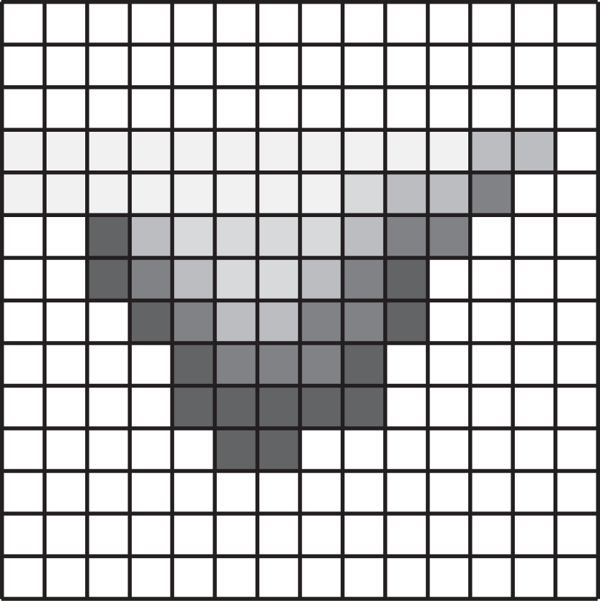
Text Scaffold Generation Step 2: Dilate & Add Visibility Weight
What is visibility weight?

Slide 20
Text Scaffold Generation Step 2: Dilate & Add Visibility Weight
What is visibility weight?

Slide 21
Text Scaffold Generation Step 2: Dilate & Add Visibility Weight
Combining Dilation & Visibility Weight:
Parameters:
w_{a} controls how much the scaffold avoids occluded regions
w_{d} is just a constant dilation amount

Slide 22
Text Scaffold Generation Step 2: Dilate & Add Visibility Weight

Slide 23
Text Scaffold Generation Step 3: Smooth Field
Convolve field with Gaussian filter

Slide 24
Text Scaffold Generation Step 3: Smooth Field
Convolve field with Gaussian filter

Slide 25
Text Scaffold Generation Step 4: Erode to Fit
Add constant value to field
Automatically chosen to make sure new field fits as tightly to the original object as possible
Causes isosurface to contract inward (i.e. erode)

Slide 26
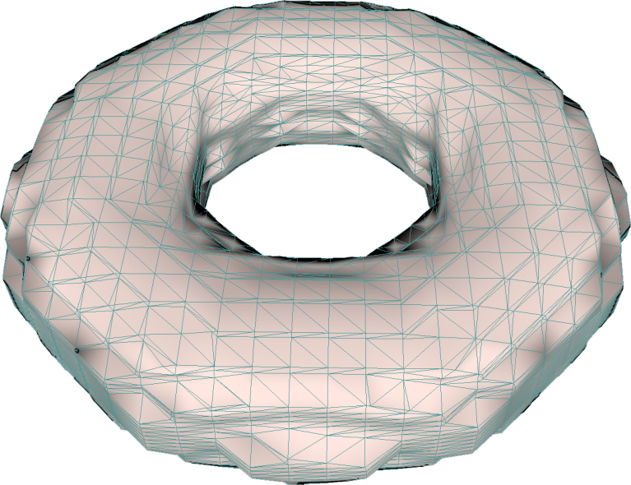
Text Scaffold Generation Step 5: Build Scaffold Mesh
We now have the scaffold…
Just need to extract a mesh from it
Using Marching Cubes*
* W. E. Lorensen and H. E. Cline. Marching cubes: A high resolution 3d surface construction algorithm. SIGGRAPH Comput. Graph., 21(4):163–169, 1987.

Slide 27
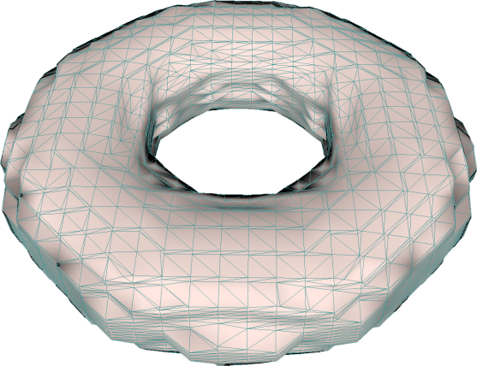
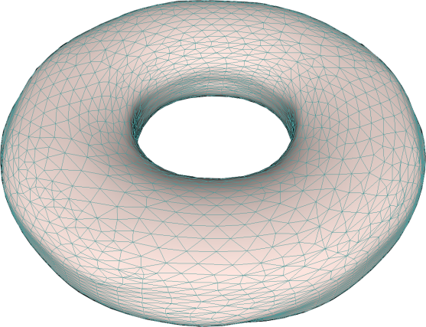
Text Scaffold Generation Step 6: Smooth Mesh
Unfortunately, mesh may still have minor sampling artifacts
Mitigated by sub-pixel precision
Perform a final smoothing pass
Taubin smoothing*
* G. Taubin. A signal processing approach to fair surface design. In Pro-
ceedings of SIGGRAPH 95, pages 351–358, Aug. 1995.

Slide 28
Outline
Introduction
Text Scaffold Generation
Labeling
Results

Slide 29
Labeling
3 classes of cartographic labels
Point
Lineal
Areal
Notes:
Put a picture of each class

Slide 30
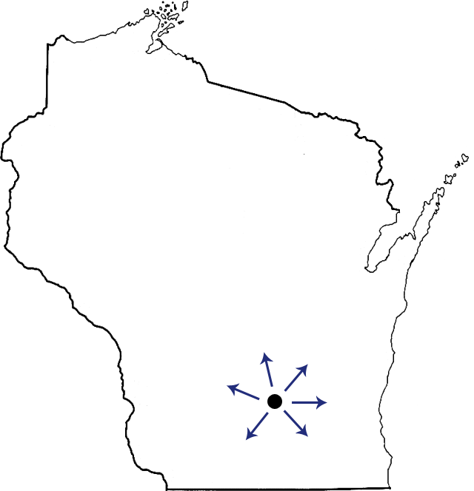
Point Labeling
3 classes of cartographic labels
Point
Lineal
Areal
Notes:
Put a picture of each class

Slide 31
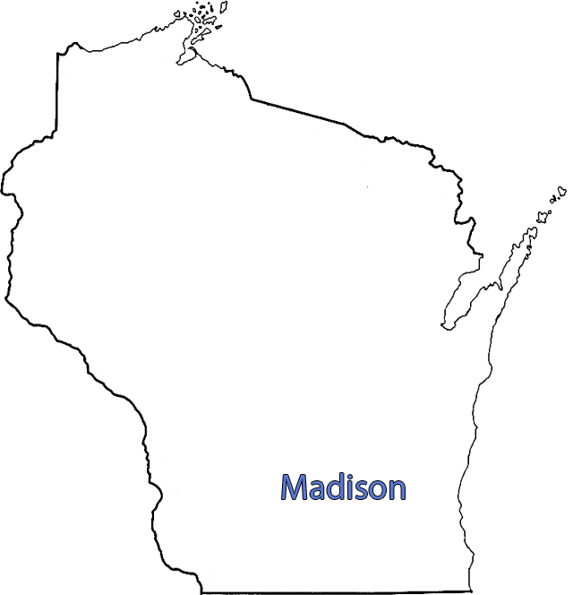
Point Labeling
3 classes of cartographic labels
Point
Lineal
Areal
Notes:
Put a picture of each class

Slide 32
Point Labeling

Slide 33
Point Labeling
Notes:
Axis of LEAST curvature

Slide 34
Point Labeling

Slide 35
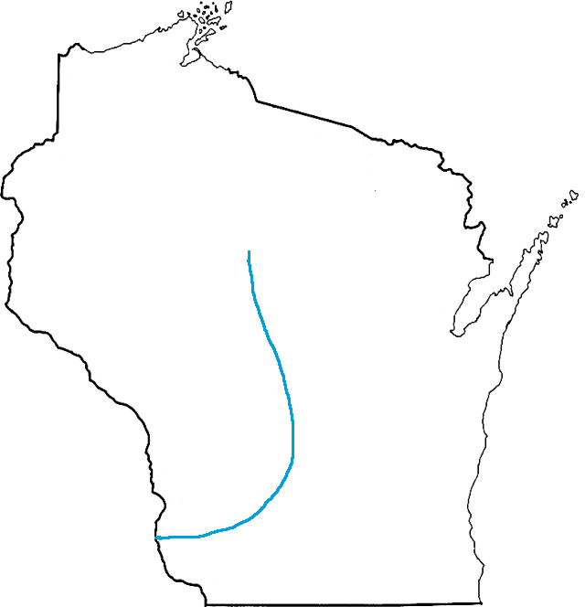
Lineal Labeling
3 classes of cartographic labels
Point
Lineal
Areal

Slide 36
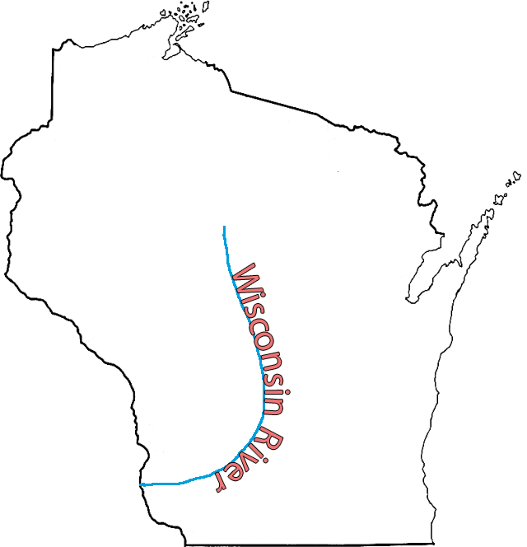
Lineal Labeling
3 classes of cartographic labels
Point
Lineal
Areal

Slide 37
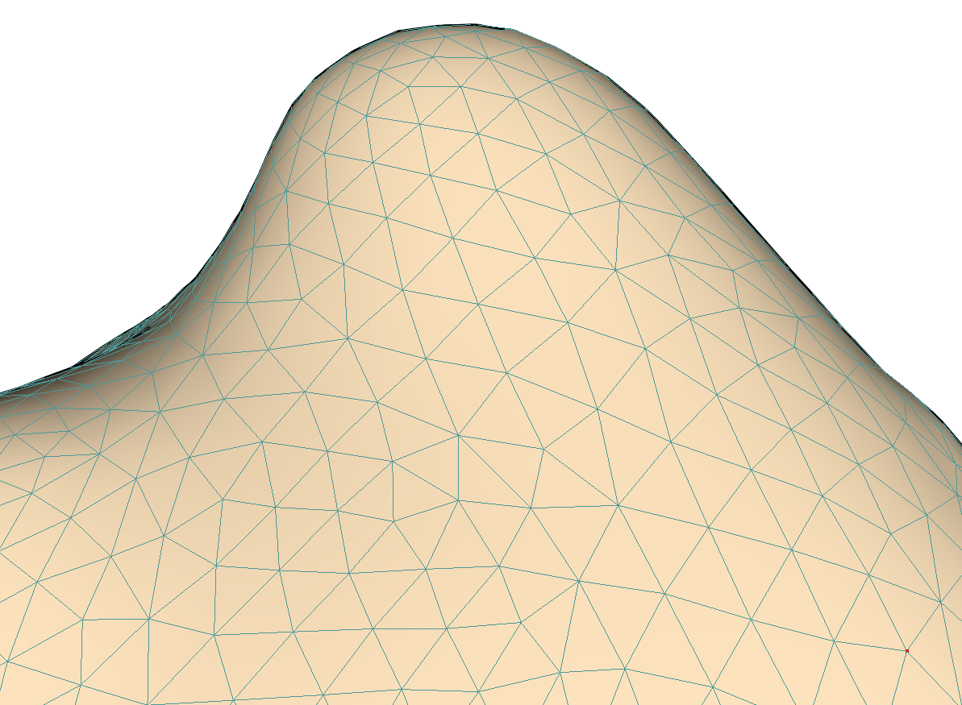
Lineal Labeling: 1) Sketching a Path

Slide 38
Lineal Labeling: 1) Sketching a Path

Slide 39
Lineal Labeling: 1) Sketching a Path

Slide 40
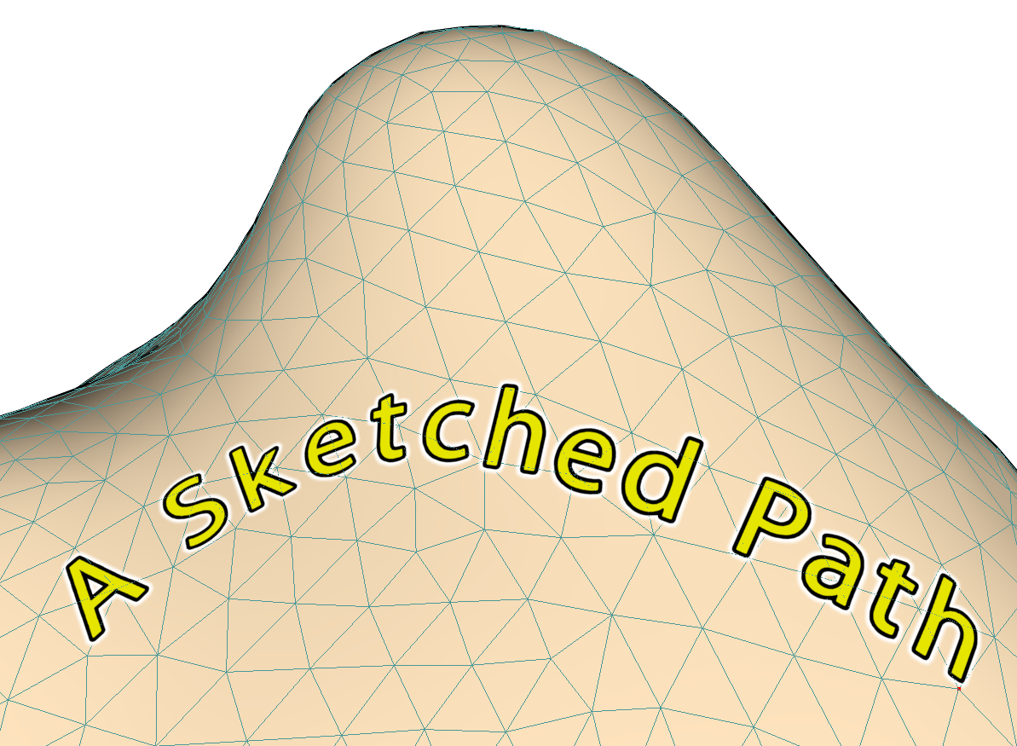
Lineal Labeling: 1) Sketching a Path

Slide 41
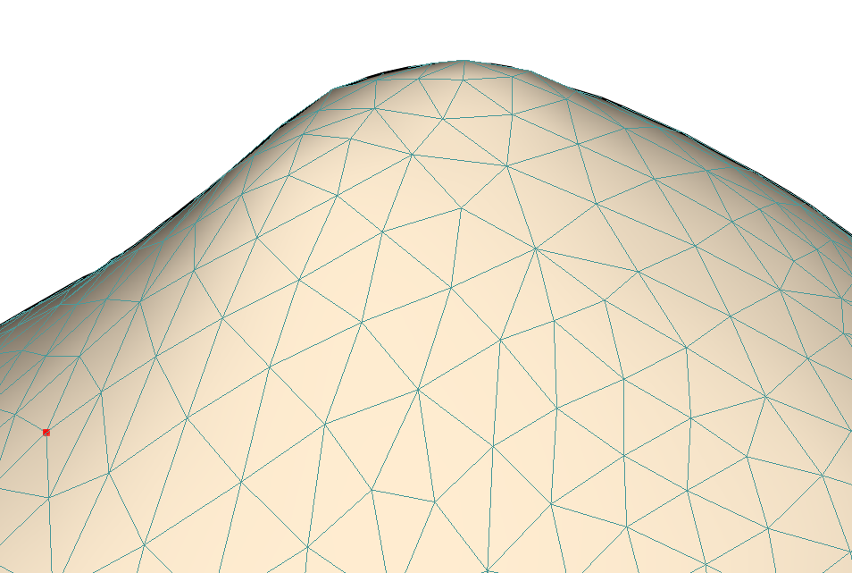
Lineal Labeling: 2) Geodesic Paths

Slide 42
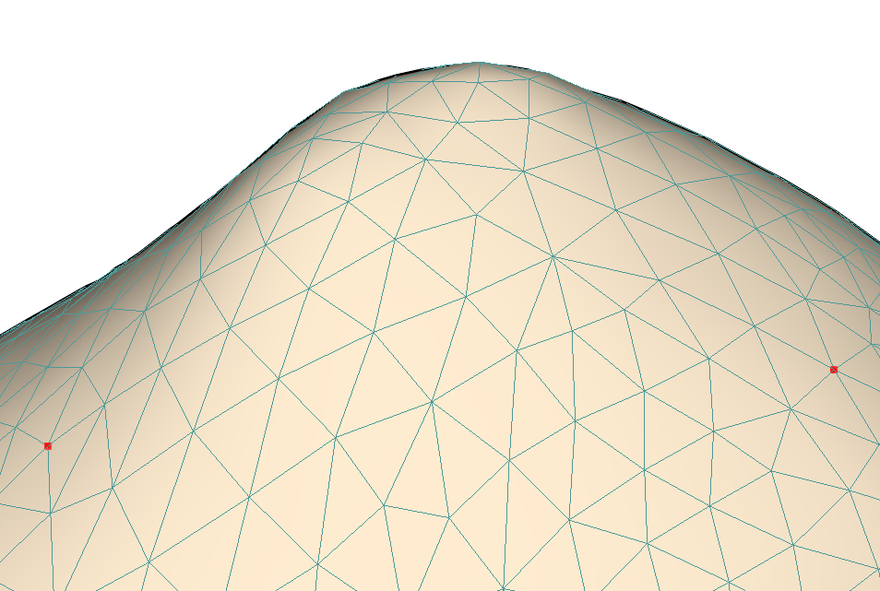
Lineal Labeling: 2) Geodesic Paths

Slide 43
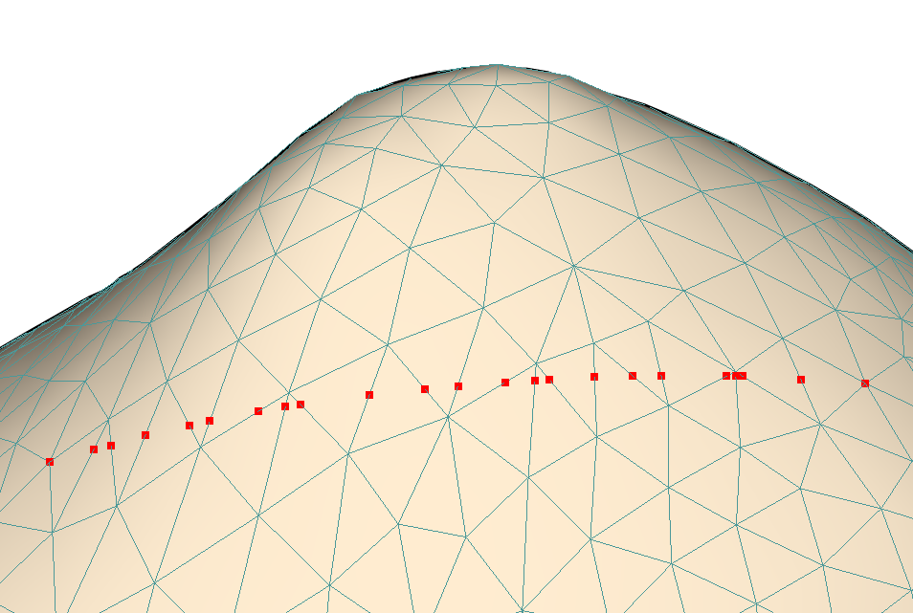
Lineal Labeling: 2) Geodesic Paths

Slide 44
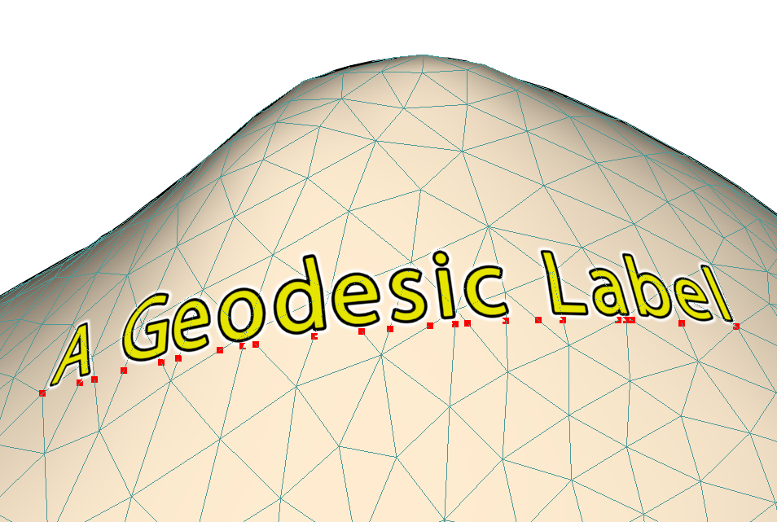
Lineal Labeling: 2) Geodesic Paths

Slide 45
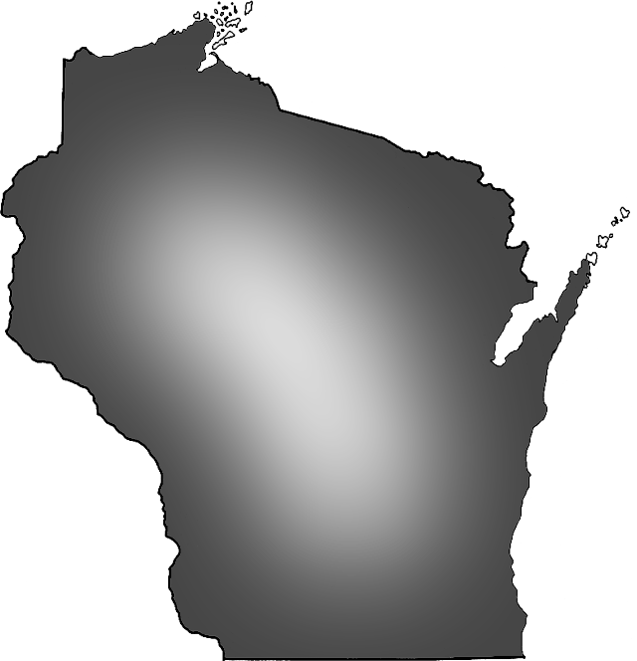
Cartographic Labeling
3 classes of cartographic labels
Point
Lineal
Areal

Slide 46
Cartographic Labeling
3 classes of cartographic labels
Point
Lineal
Areal

Slide 47
Areal (Region) Labeling
Notes:
Given an annotated region, first project its vertices onto the scaffold:

Slide 48
Areal (Region) Labeling
Notes:
Next, parameterize the region, and compute medial axis transform in parameter space …

Slide 49
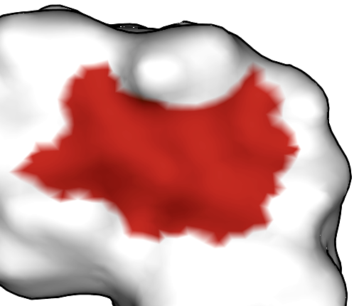
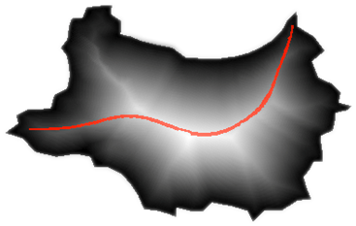
Areal (Region) Labeling
Notes:
… build a path along the longest medial axis …

Slide 50
Areal (Region) Labeling
Notes:
… and finally, apply the label, centered along that path.

Slide 51
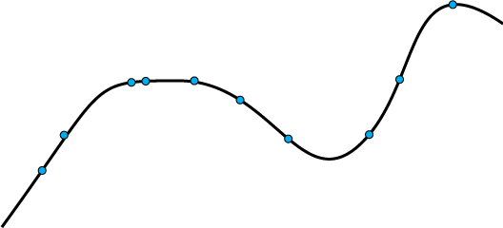
Path Smoothing
Common among all labeling schemes
First, take a sequence of points as input
Not necessarily on the scaffold surface
Optionally add points (interpolate)

Slide 52
Path Smoothing
Then, iterate the following:
Fix endpoints
Average position of each point with its neighbors in sequence
Project back onto surface

Slide 53
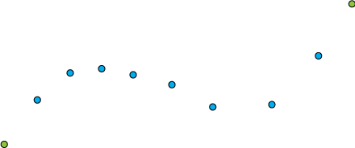
Path Smoothing
Then, iterate the following:
Fix endpoints
Average position of each point with its neighbors
Project back onto surface

Slide 54
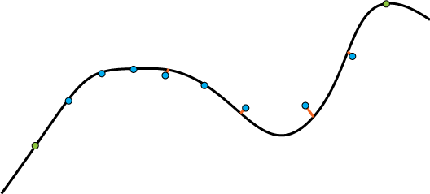
Path Smoothing
Then, iterate the following:
Fix endpoints
Average position of each point with its neighbors in sequence
Project back onto surface

Slide 55
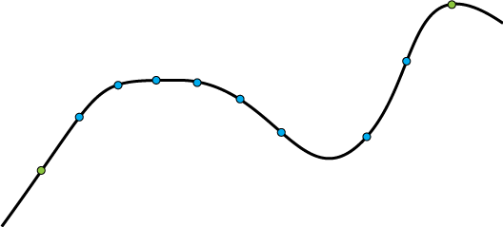
Path Smoothing
Then, iterate the following:
Fix endpoints
Average position of each point with its neighbors in sequence
Project back onto surface

Slide 56
Path Smoothing
Then, iterate the following:
Fix endpoints
Average position of each point with its neighbors in sequence
Project back onto surface

Slide 57
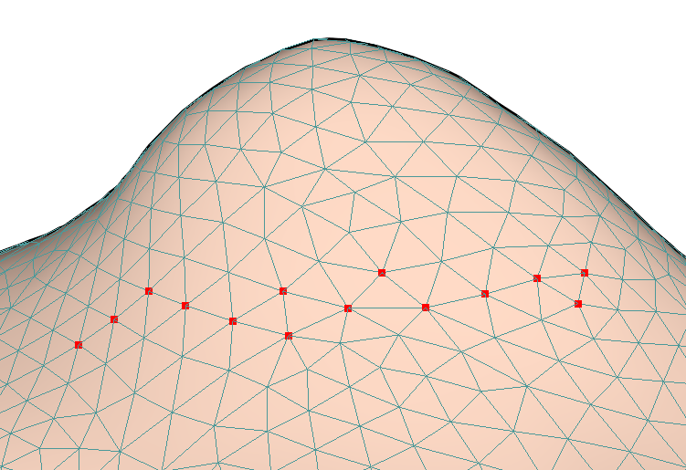
Path Smoothing

Slide 58
Path Smoothing

Slide 59
Path Smoothing

Slide 60
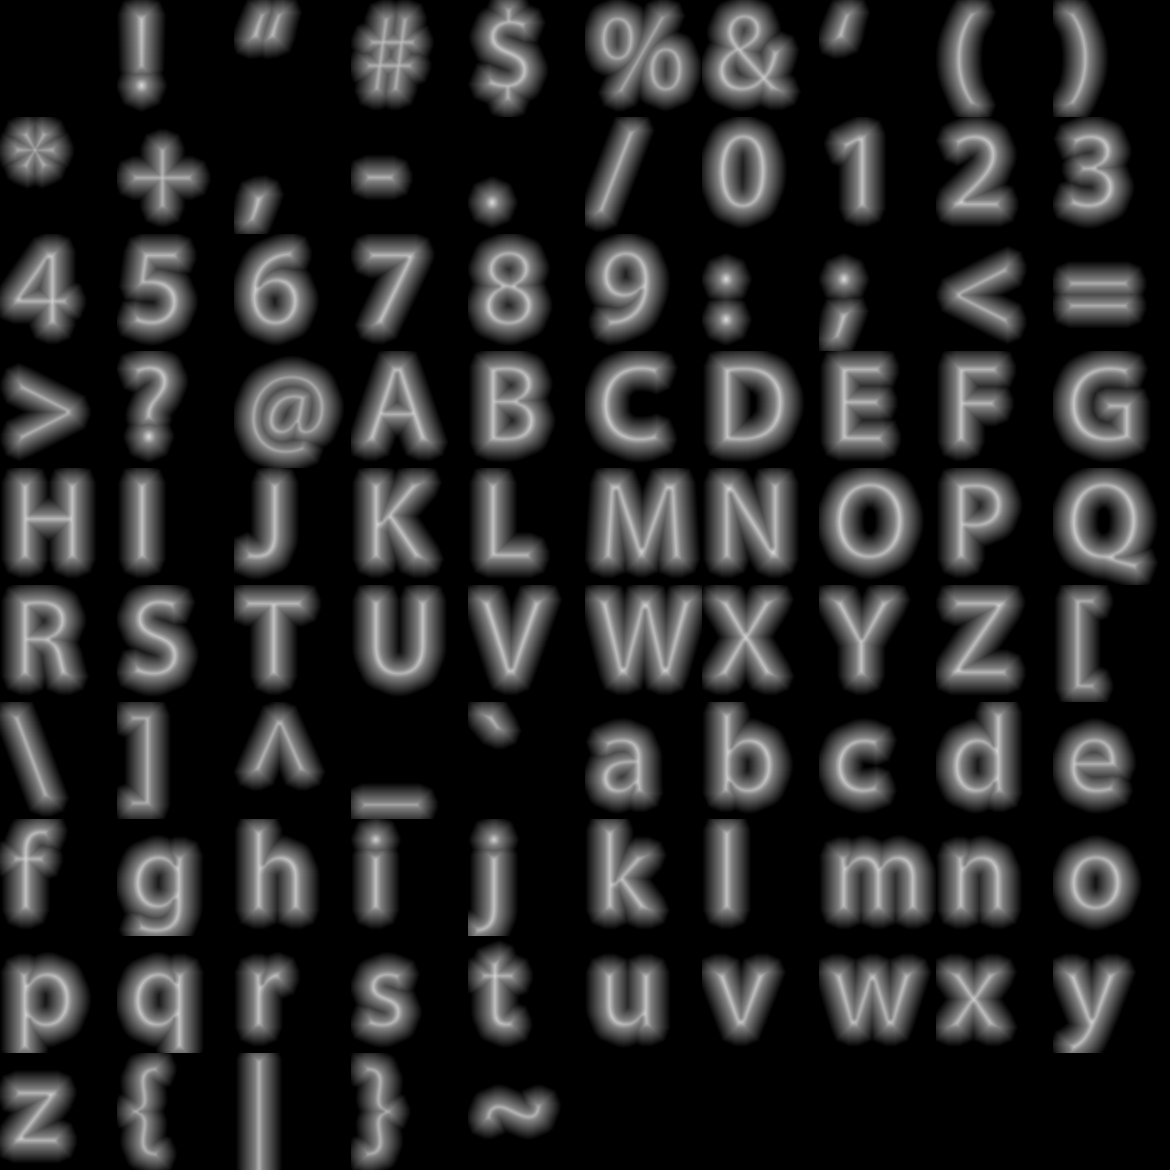
Text Rendering
We use alpha-tested magnification* to render letters
Lets us draw large letters with a small (128x128) texture, with no visible aliasing
Can add outline, glow effects by simple modifications of the shader
* C. Green. Improved alpha-tested magnification for vector textures and special effects. In SIGGRAPH ’07: ACM SIGGRAPH 2007 courses, pages 9–18, New York, NY, USA, 2007. ACM.

Slide 61
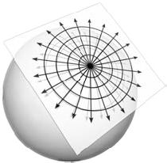
Text Rendering
Each letter is given its own local parameterization
Letter = decal
Built using exponential map method*
Letter orientations are computed in parameter space
Baseline is a weighted average of nearby path segments
* R. Schmidt, C. Grimm, and B.Wyvill. Interactive decal compositing with discrete exponential maps. ACM Transactions on Graphics, 25(3):603–613, 2006.

Slide 62
Outline
Introduction
Text Scaffold Generation
Labeling
Results

Slide 63
Results

Slide 64
Results
Notes:
Describe better how labels are done here.

Slide 65
Results
Notes:
Describe better how labels are done here.

Slide 66
Results
Notes:
Describe better how labels are done here.

Slide 67
Results
Notes:
Describe better how labels are done here.

Slide 68
Results

Slide 69
Results

Slide 70
Results

Slide 71
Results

Slide 72
Limitations
Intrinsic to Surface Labeling
Fixed labels may not always be oriented toward viewer
Can’t guarantee uniform letter size, orientation on screen
Unique to our approach
Scaffold parameters not necessarily intuitive
Tradeoff between various goals
Future Work
Independent steps (scaffold generation, path formation, lettering)
One inflexible surface may not offer best location for text path
Text paths ignore one another
No overlap avoidance

Slide 73
Conclusion
Text scaffolds:
Amenable to legible, proximal annotation of 3D models
Are quick to compute, with low overhead
Ideally suited for large models, with dense labels
Our system includes methods for:
Applying point labels
Geodesic path layout
Path ‘Sketching’
Automatic labeling of annotated regions
Notes:
Add key ideas

Slide 74
Thanks!
Questions?
Thanks also to CIBM grant NLM-5T15LM007359

